Slide 1
Welcome SHS Class of 2026

Slide 2
Administration
Brandon Boyd– Principal
Rachel Lee – Assistant Principal
Linsey Balmos– Counselor for last name A-L
Heather Bisson– Counselor for last name M-Z
Tammy Turnbo – Counseling Assistant
Renee’ Oas– Secondary PEIMS Specialist
Maria Cebreco– Registrar/Attendance
Cyndi Danek– Secretary
Paul Baird – Athletic Director

Slide 3
Graduation Requirements
Distinguished Level of Achievement** 26 Credits
English — 4 credits | English 1, 2, 3, 4
Math — 4 credits | Algebra I, Geometry, Algebra II Additional Math credit
Science — 4 credits | Biology Three additional Science credits
Social Studies — 4 credits | World Geography, World History, U.S. History, Government, and Economics
Languages other than English — 2 credits
Fine Arts — 1 credit
Physical Education — 1 credit Health – .5 credit/Speech – .5 credit Technology Applications – 1 credit
Electives — 4 credits (Specific to Endorsement)

Slide 4
Graduation Requirements
STAAR EOC Exams
English 1
Algebra 1
Biology
English 2
US History

Slide 5
Endorsements
STEM Business and Industry Public Service Arts and Humanities Multidisciplinary

Slide 6
What is an Endorsement?
An area of study while in high school (i.e., band, Spanish, Ag)
An Endorsement is established when a pathway is chosen beginning of 9th grade year
Colleges DO NOT care which endorsement a student graduates with, just that they have ONE
It is advisable that students take relevant classes towards their college major or future career, but it is not a requirement for admissions.
There is no endorsement that is “better”, or “higher”, or “more college preparatory”. The level of classes a student takes will determine how rigorous a transcript appears to a college during the admissions process, not their endorsement.
To allow for the most opportunities after high school, our recommendations are:
English 4 for the final English credit
Chemistry AND Physics
Math every year in high school, even if Algebra 1 in 8th grade
Four Social Studies credits (already required by SHS)

Slide 7
SHS course requirements
In addition to state mandated credits, SHS requires:
Four Social Studies credits: World Geography, World History, US History & Government/Economics
Health--.5 credit
Health
Principles of Health Science (full year)
Speech-.5 credit
Professional Standards in Ag
Professional Communications
May be earned through Debate (full year)
Technology Applications—1.0 credit
Principles of Information Technology
Computer Science (must have completed Algebra 1)

Slide 8
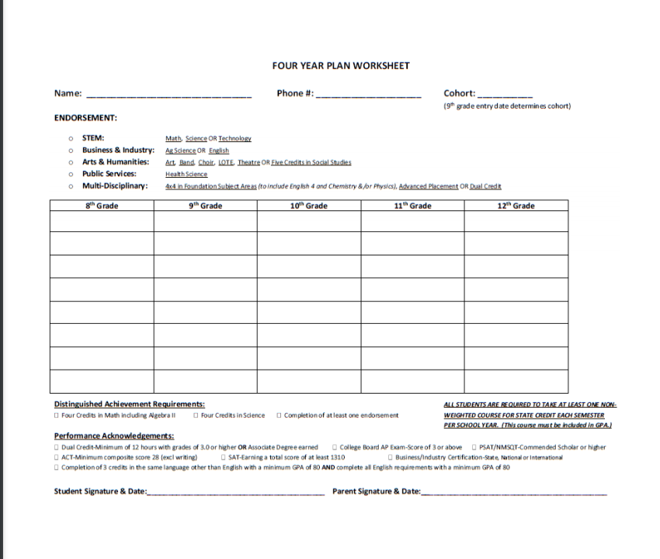
Every student in TX is required to fill out a four year plan with their signature and a parent/guardian signature PIOR to starting high school
These four year plans are kept in the counselor’s office and handed back to students each year to make changes.

Slide 9
Four year Plans
Four year plans are filled out at the end of 8th grade year
Students choose an endorsement at this time
Endorsements can be changed AT ANY TIME.
Parents are notified when a student changes their endorsement
A parent and student signature are required on four year plans
Not sure what endorsement to choose? Multidisciplinary
PLEASE return your student’s 4 year plan to their counselor

Slide 10
FYI: Important If your student does not return their four year plan, we will choose their classes for them!

Slide 11
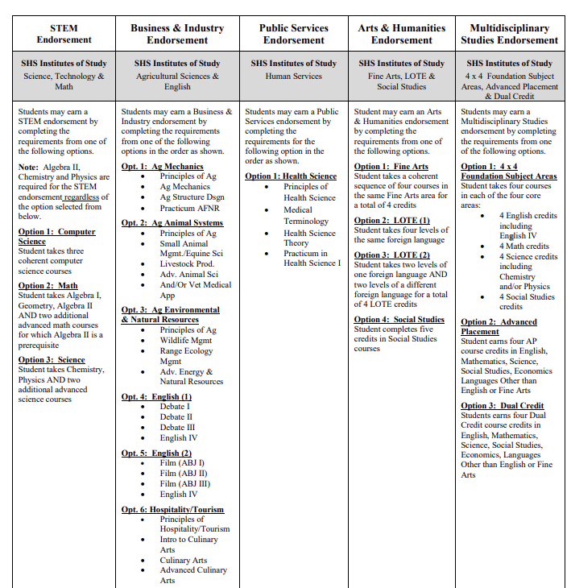

Slide 12
Selecting Courses for 9th grade
ENGLISH: English 1 or Honors English 1 (Summer Reading Requirement)
MATH: Algebra 1, Honors Algebra 1, Geometry or Honors Geometry
SCIENCE: Biology or Honors Biology
SOCIAL STUDIES: World Geo or Honors World Geo
FOREIGN LANGUAGE: Spanish 1, Spanish II, or Honors Spanish 2
PE or Athletics: Must be in a team sport for Athletics
Speech/Health or Technology Credit
Fine Arts
Endorsement Elective(s)
Study Hall
UIL Academic Advanced Honors 1(take this class to be involved in UIL academics)
1 course must be unweighted

Slide 13
Salado Academic Planning Guide is on the High School website.
https://shs.saladoisd.org/532623_3

Slide 14
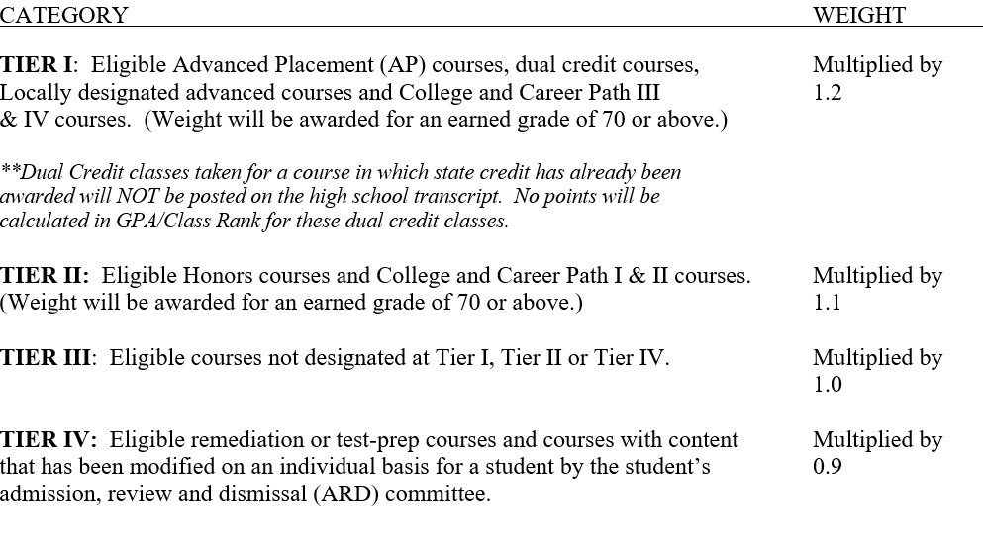
GPA

Slide 15
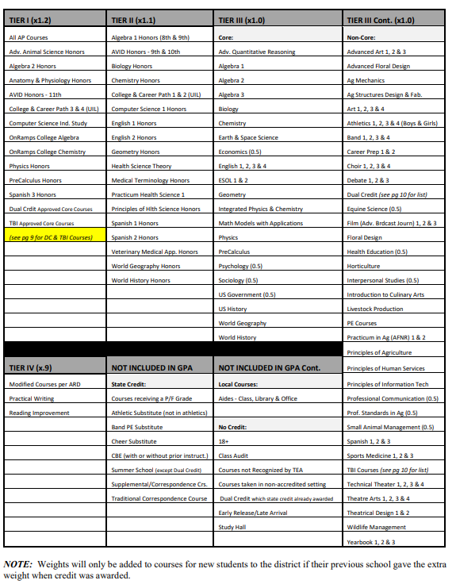
Course weight
*located on page 4 in the course guide

Slide 16
College Credit Options
Dual Credit on SHS Campus
Texas Bioscience Institute (TBI) through Temple College (Alg. 1, Geom., Alg II)
Dual Enrollment with UT On-Ramps on SHS Campus

Slide 17
Dual Credit
Fall of Sophomore year, students will take the TSI (Texas Success Initiative) test in ELAR (Reading & Writing).
Must make a TSI score of 945 (or higher) with an Essay score of 5-8 in order to be dual credit ready.
Dual credit is taught through Temple College through a professor on the SHS campus.
Junior year:
Fall: English 1301 & US History 1302 (US History EOC STAAR given in December) 6 college credits
Spring: English 1302 & US History 1301; 6 college credits=12 total
Senior year:
Fall: English 2322 & Gov’t 2305; 6 college credits
Spring: English 2323 & Econ 2301; 6 college credits=12 total (potential 24 total college credits)
More information to follow Spring of student’s sophomore year.
Please refer to the academic planning guide for more information.

Slide 18
Texas bioscience institute (tbi)
Fall of Sophomore year, students will take the TSI (Texas Success Initiative) test in ELAR (Reading & Writing) and Math.
Must make a TSI score of 945 (or higher) with an Essay score of 5-8 and a Math score of 950 in order to be dual credit ready.
TBI is a half day program on the Temple College campus.
Students take English, US History, Math, Science and earn an Associates Degree.
Geared towards those interested in STEM fields.
Must have already taken Algebra I, Geometry & Algebra II.
Please refer to the academic planning guide for more information.

Slide 19
Dual Enrollment/ut on-ramps
SHS offers On-Ramps courses through The University of Texas.
On-Ramps Algebra II (high school Algebra II & Math 1314—3 college credits)
On-Ramps Chemistry (high school Scientific Research & Design, CHEM 1411 & Lab—4 college credits)
On-Ramps Biology (high school Scientific Research & Design II, BIOL 1306 & Lab—4 college credits)
TSI is not required, but recommended
Please refer to the academic planning guide for more information.

Slide 20
Advanced Placement
What is AP?
The advanced placement (AP) Program of the College Board enables students to complete college-level
studies at Salado High School. The primary goals of the AP Program are to enrich the secondary school experience of students ready to apply themselves to college-level courses and to provide the means by which colleges may grant credit or placement, or both, to students with satisfactory AP test scores.
Benefits of AP
The benefits of the AP Program extend beyond students receiving college credit, placement, or both for
exam performance. AP courses teach them how to manage their time while they learn how to deal
with college-level work.
Enrolling in AP Classes
Students entering high school need to plan with their counselor to insure that all prerequisite courses are
scheduled early enough to allow them to take the AP course(s) of their choice at the senior high level. Students pay an AP Examination fee per test in early spring.

Slide 21
Credit By Exam and Supplemental Courses
Texas Tech ISD – Credit By Exam and Supplemental Courses
Must be approved by SHS Counselor
Paid for by the parent
Supplemental Course: $250 a class plus books and fees
Credit by Exam: $70 per semester exam
Not included in GPA
3 credit maximum for supplemental courses
No EOC tested courses
Studying/Review is the student’s responsibility
Passing Grades:
Supplemental Course: 70 or above
CBE: 80 or above

Slide 22
Schedule Information
Students served through 504 will be contacted by the serving counselor
Students served through Special Education will have transition meetings prior to high school
Schedule changes can be made through the second week of the school year
Students enrolled in Honors courses can move to on level courses within the first 6 weeks of each semester

Slide 23
UIL Eligibility
Grade Checks for Gain/Lose:
1st 6 weeks
End of each 9 week grading period
Grade Checks for Gain Only:
Every 3 weeks
Must pass ALL classes at a grade check to be eligible

Slide 24
Nest 2022
Saturday in August
In the morning
Welcome from Student Council
Tour of the School
Information Sessions/Break-outs
We feed you!
Excellent way to meet new 9th graders & maybe meet your teachers.

Slide 25
Please return your four year plan to the high school or the middle school by March 31st!

Slide 26
QUESTIONS
Linsey Balmos-Counselor for last name A-L
linsey.balmos@saladoisd.org
254-947-6973
Heather Bisson-Counselor for last name M-Z
heather.bisson@saladoisd.org
254-947-6963

